Slide 1
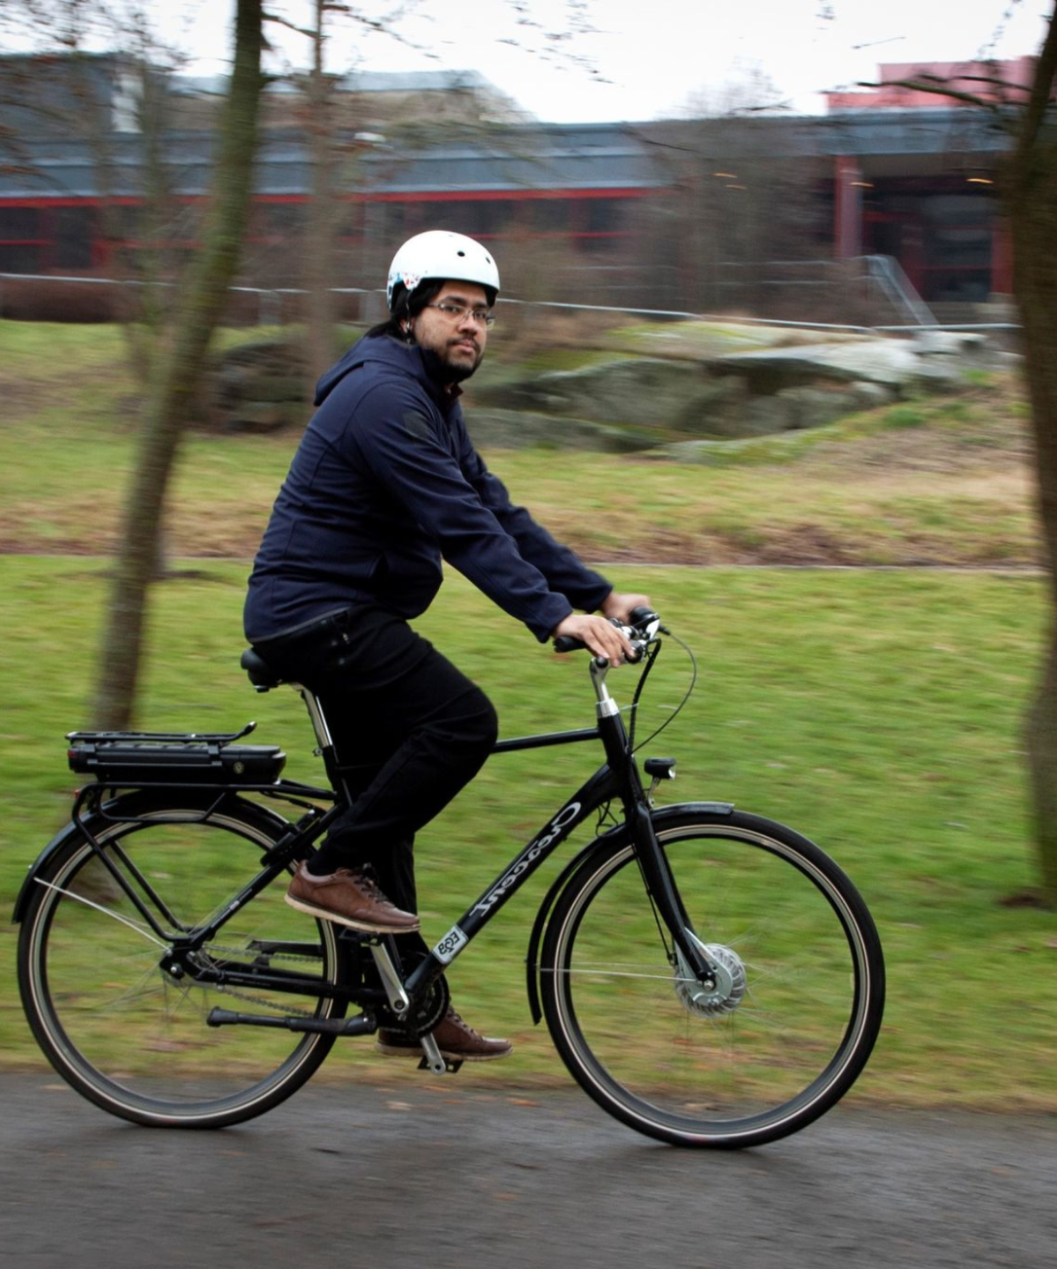
Salman Yahya
Test Engineer
Personnummer: 8710199699 Happy family with two son Nationality: Swedish Language: Swedish/ English Driving License: B

Slide 2
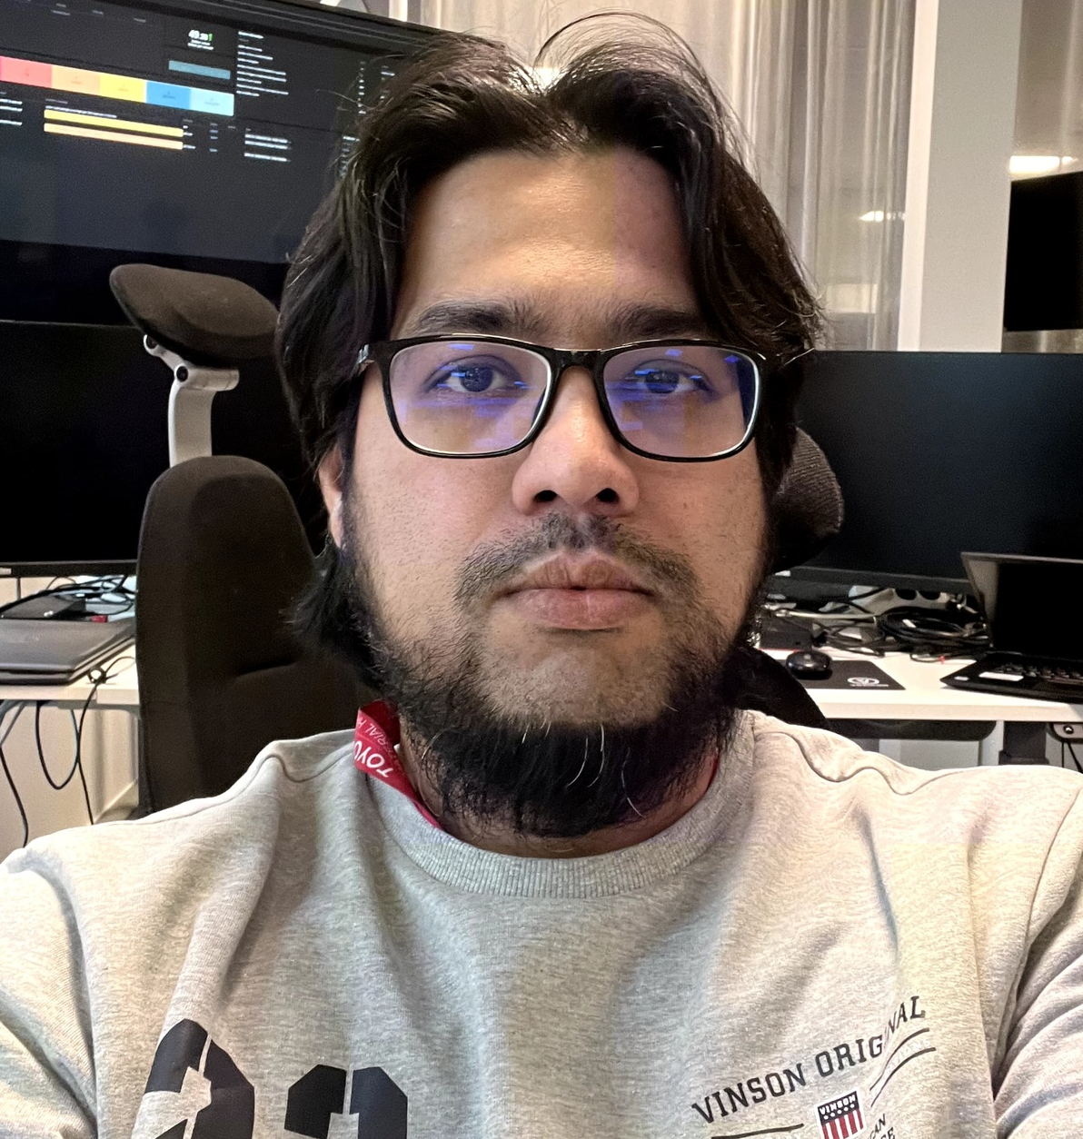
Salman Yahya
I am a technically skilled, detail-oriented professional interested in programming, troubleshooting, and data analytics. I am seeking a challenging role where I can leverage my technical expertise and problem-solving skills to develop, test, and maintain innovative solutions. I am passionate about developing and updating myself with emerging technologies and continuously honing simulation, analytics, and testing skills to drive impactful progress and innovation in my field.
I am highly interested in
HIL Testing
Simulation and Design
Customer collaboration
Execute tests alongside other colleagues.
Contribute to new design solutions by testing, analyzing, and customer feedback.
Continuous Integration (CI/CD)

Slide 3



Work Experience
March 2023 - June 2024
January 2023 - June 2023
October 2013 - February June 2016
Support Engineer at Toyota Material Handling, providing support for various Technical services, managing hardware and software, troubleshooting, and implementing modern IT technologies.
System Developer at Chalmers University of Technology, developing a bioinformatics pipeline for extracting biomedical data from scientific publications using C#, Blazor, Entity Framework, and PHP.
As Distribution Manager I worked with a team to distribute posts, newspapers, and essential documents, ensuring timely and accurate delivery. Regularly reported progress and any issues to the main office to maintain efficiency.
Now
Begin
January 2023 - June 2023
June 2016 - February 2020
Project at Gapwaves AB, designing and simulating the analysis of a microstrip-to-dual-track waveguide for vehicle radar systems at 77 GHz using electromagnetic simulation software CST.
Technical Support Engineer at Innoventure IT, providing technical support, troubleshooting, and resolving customer issues, while maintaining client relationships and documenting knowledge.

Slide 4
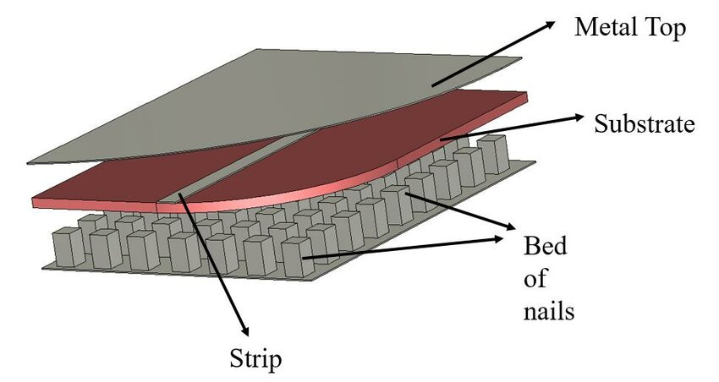
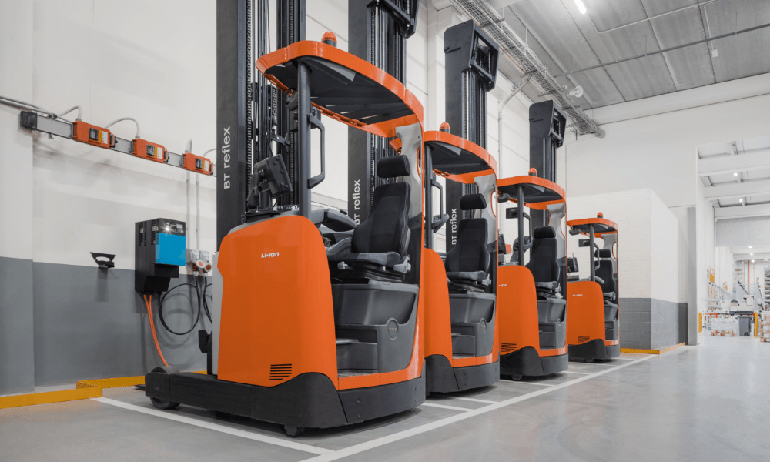
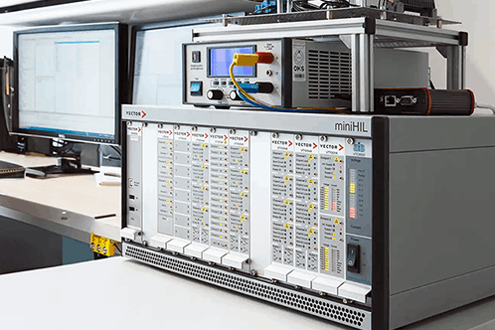
Work Experience
March 2023 - June 2024
Support Engineer at Toyota Material Handling, supporting various Technical services related to AVG, managing hardware and software, troubleshooting, and implementing modern IT technologies.
Microstrip line has been simulated for 78Ghz GapWave tech
AVG Vehicle testing
HIL System
Required Skill:
.Electromagnetic Design
Test and Simulation
Matlab/ Simulink
CST Studio
Ansys HFSS
Required Skill:
.Customer Collaboration
Continuous Integration (CI/CD)
C Programming / Powershell
Matlab/ Simulink
Labview
CAN
January 2023 - June 2023
Project at Gapwaves AB, designing and simulating the analysis of a microstrip-to-dual-track waveguide for vehicle radar systems at 77 GHz using electromagnetic simulation software CST.

Slide 5



Education
Master Study in Communication Engineering
YH Utbildning in C#.Net Development
Bachelor in Electrical and Electronics Engineering
Completed a masters degree in Communication Engineering from Chalmers University of Technology, focused on developing advanced communication systems and technologies.
Fullstack Education in C#.Net that includes C# Programming, SQL, AWS/ Azure, Gith, React.js
Holds a bachelor's degree in Electrical and Electronics Engineering from International Islamic University of Chittagong, providing a strong foundation in electrical and electronics principles.
Extensive educational background in communication, robotics, Automation, and electrical engineering along with programming equipping me with the necessary knowledge and skills to excel in technology-driven roles.

Slide 6






Projects
MATLAB and MATLAB Simulink Projects
Microstrip Design with CST
Worked on projects using MATLAB and MATLAB Simulink for tasks like data analysis, signal processing, and control system design.
Design and simulate Microstrip antenna for GapWave teknik for car Radar system that operates in 77 Ghz frequency with CST Studio.
Embedded System project with C/C++
Robot Simulation Project
Worked with design and development of embedded system using C/C++ with Raspberry Pi
Worked with different practical and code-based project by using RAPID programming.
Python-based Projects
Satellite Communication
Developed projects using Python, focusing on areas such as web scraping, data visualization, and automation.
Seamless Satellite Communication with Earth and Planet Mars with 99.999% availability
These diverse programming-based and technical projects have allowed me to develop a strong technical skillset and a proven ability to deliver innovative solutions across various domains.

Slide 7

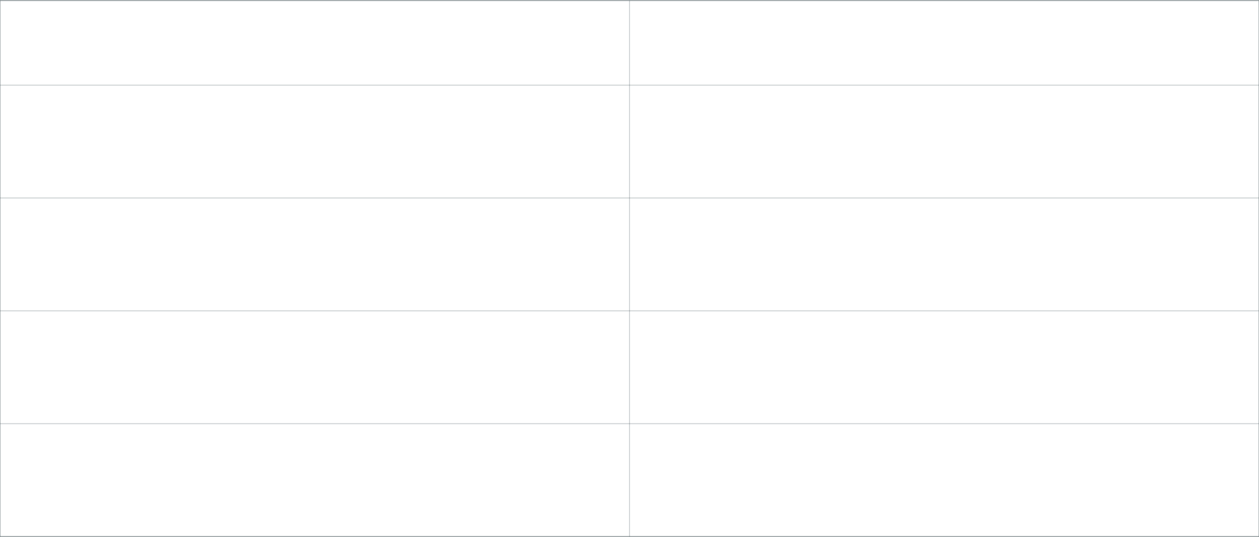
Certifications/ Courses
Certification
Description
Embedded System
Certification in designing, developing, and troubleshooting embedded systems, including microcontrollers, sensors, and communication protocols.
HIL for Power Electronics
Certification in hardware-in-the-loop (HIL) simulation for power electronics systems, enabling the testing and validation of power electronic circuits and control algorithms.
Robot Modelling
Certification in robot modelling, simulation, and control, including kinematics, dynamics, and motion planning.
Industrial Automation
Certification in industrial automation technologies, such as programmable logic controllers (PLCs), and industrial networking.
*Salman Yahya's Resume

Slide 8
Skills
MATLAB and MATLAB Simulink
Proficient in using MATLAB and MATLAB Simulink for mathematical modeling, simulation, and algorithm development.
Hardware and Software Installation and Maintenance
Skilled in installing, troubleshooting, and maintaining various hardware and software components.
CST Studio Suite
Experienced in using the CST electromagnetic simulation software for antenna and microwave circuit design.
PLC Programming
Knowledgeable in programming and configuring Programmable Logic Controllers (PLCs) for industrial automation and control systems.
CANoe Comfortable using CANoe
PowerShell
Proficient in using PowerShell, a powerful automation and configuration management tool, for managing Windows-based systems and servers.
C/ C++
Working knowledge in C and C++.
RAPID Programming
Installation and programming Robots in industry.
Linux and PowerShell Scripting
Experienced working in Linux environment and with PowerShell.
Python
Skilled in utilizing Python for scripting, data analysis, and automating various tasks.

Slide 9




Interests
Outdoor Activities
Front-end Web Development
Technical Interest
Love to Cook
Enjoys fishing and spending time in natural settings such as by the sea and in the mountains.
Passionate about exploring the latest advancements in front-end web development technologies.
I love to build small hobby projects with Arduino and Raspberry
I love to cook in my leisure time. I am good in Indian, Italian and Swedish menues.
Maintains a balanced lifestyle by engaging in a variety of interests, from outdoor pursuits to creative endeavors in the kitchen and the world of technology.

Slide 10


Voluntary Activities
Ishraq Akademi
Lokala Hyregästförening
Läxhjälp
Involved in providing educational and social support to children and youth in the local community.
Board member of local tenant's association to advocate for the rights and interests of residents in the neighborhood.
Helping local children with Läxhjälp
Through these voluntary initiatives, I have gained valuable experience in community engagement, social responsibility, and advocating for the needs of society.

Slide 11
Events & Seminars
Catia Discovery Day
Attended an event organized by Dassault Systemes to explore the latest features and capabilities of their Catia software for 3D CAD design and product development.
Matlab Day
MATLAB Day is an interactive event focused on hands-on workshops, coding challenges, and project showcases. It offers networking and learning opportunities for enthusiasts eager to explore MATLAB’s diverse applications and innovations.
Web Development Seminar
Attended a seminar focused on the latest techniques and best practices in responsive web design, cross-browser testing, and modern front-end development frameworks like Bootstrap.
IT Infrastructure Seminar
Participated in a seminar covering the fundamentals of network administration, server installation and maintenance, and troubleshooting common hardware and software issues.

Slide 12




Contact information
Opalgatan 37, Västra Frölunda
Telephone: 0761883683
salman.yahya.soc@outlook.com
salmancth.github.io/info

